Slide 1
Type of Attribute in DBMS
9

Slide 2
Type of attribute
Single attribute
Composite attribute
Single valued attribute
Multi valued attribute
Base attribute or store attribute
Derived attribute
Key attribute

Slide 3
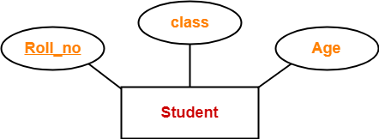
Simple attribute
All the attributes which can not be divided further.

Slide 4
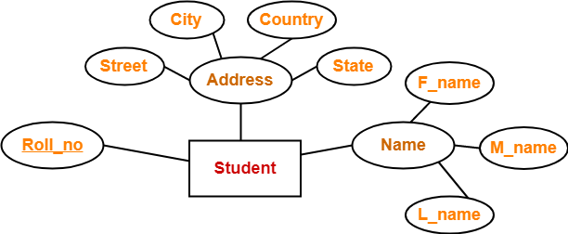
Composite Attributes
Composite attributes are those attributes which are composed of many other simple attributes.

Slide 5
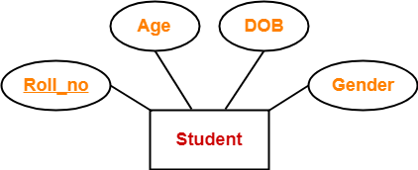
Single-Valued Attribute
Single valued attributes are those attributes which can take only one value for a given entity from an entity set.

Slide 6
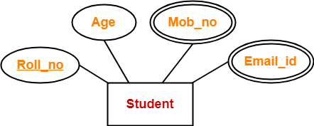
Multi Valued Attributes
Multi valued attributes are those attributes which can take more than one value for a given entity from an entity set.

Slide 7
Base/Store attribute
Stored attribute is an attribute which are physically stored in the database.
Assume a table called as student. There are attributes such as student_id, name, roll_no, course_Id. We cannot derive value of these attribute using other attributes. So, these attributes are called as stored attribute.

Slide 8
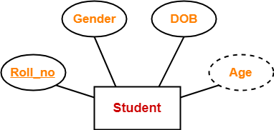
Derived Attributes
Derived attributes are those attributes which can be derived from other attribute(s).

Slide 9
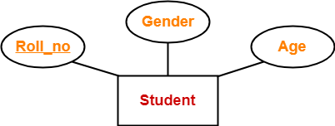
Key attribute
Key attributes are those attributes which can identify an entity uniquely in an entity set. Here, the attribute “Roll_no” is a key attribute as it can identify any student uniquely.

Slide 10


